Slide 1
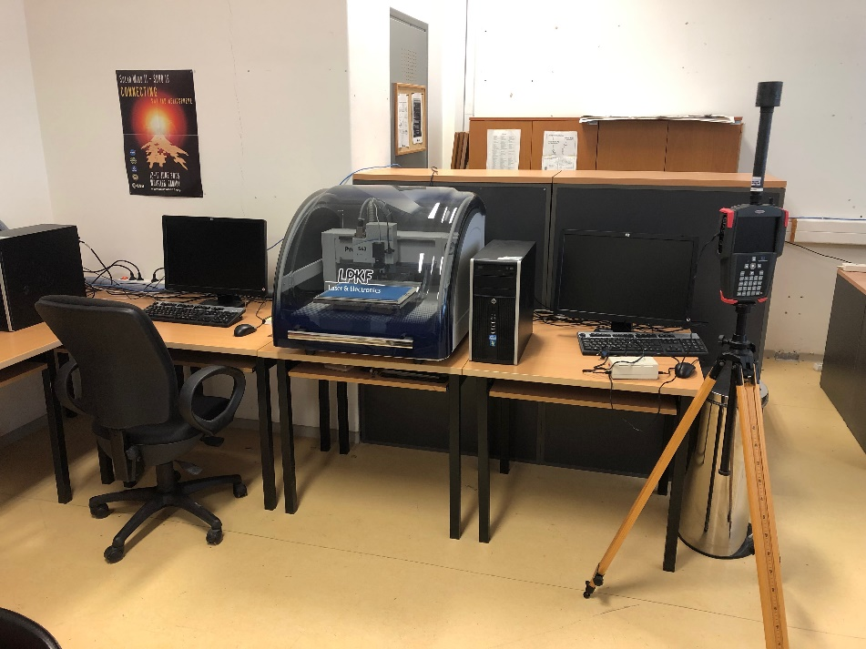

Τηλεπικοινωνιακά Δίκτυα
ΠΜΣ Μηχανικών Ηλεκτρονικών Υπολογιστών και Δικτύων
Διδάσκοντες
Κωνσταντίνος Αγγέλης
Καθηγητής
Ανδρέας Τσορμπατζόγλου
Επίκουρος Καθηγητής
Τμήμα Πληροφορικής & Τηλεπικοινωνιών – Πανεπιστήμιο Ιωαννίνων

Slide 2
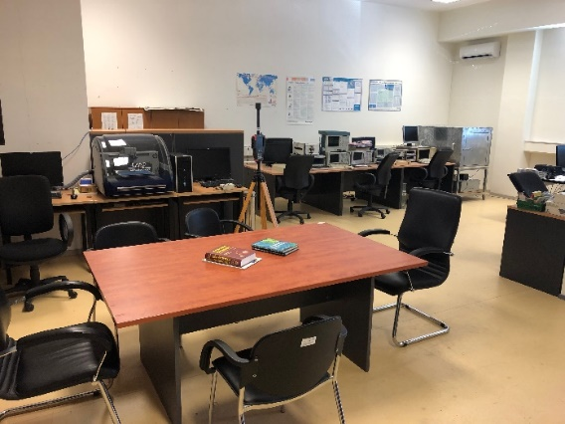
Τηλεπικοινωνιακά Δίκτυα
ΠΜΣ Μηχανικών Ηλεκτρονικών Υπολογιστών και Δικτύων
Βασικές αρχές μετάδοσης
Δίκτυα επικοινωνιών
Τεχνολογία ασύρματης επικοινωνίας
Το ασύρματο κανάλι
Ορθογωνική πολυπλεξία διαίρεσης συχνότητας
Διασπορά φάσματος
Αρχές Διάδοσης Σημάτων - Κυψελοειδή ασύρματα δίκτυα
Συστήματα 4ης-5ης γενιάς και LTE-Advanced
Συστήματα MIMO
Επικοινωνίες μεγάλης εμβέλειας
Συνεργατικά Τηλεπικοινωνιακά Συστήματα
Οπτικά Δίκτυα
Τμήμα Πληροφορικής & Τηλεπικοινωνιών – Πανεπιστήμιο Ιωαννίνων

Slide 3
Σύγχρονα ασύρματα δίκτυα
Οι τεχνολογίες MIMO & OFDM σε συνδυασμό αποτελούν τον ακρογωνιαίο λίθο στα αναδυόμενα ευρυζωνικά ασύρματα δίκτυα
OFDM → Τεχνική Βασιζόμενη στο Διαφορισμό

Slide 4
Τεχνικές Διαφορισμού (Diversity Techniques)
Ο Διαφορισμός (Diversity) βασίζεται στο γεγονός ότι ανεξάρτητα κανάλια υφίστανται ανεξάρτητα φαινόμενα διαλείψεων
Space diversity – techniques involving physical transmission path, spacing antennas
Frequency diversity – techniques where the signal is spread out over a larger frequency bandwidth or carried on multiple frequency carriers
Time diversity – techniques aimed at spreading the data out over time
Use of diversity
  Selection diversity – select the best signal
  Combining diversity – combine the signals

Slide 5
MULTIPLE INPUT MULTIPLE OUTPUT (MIMO) ANTENNAS
Use antenna arrays for
  Diversity (Διαφορισμός) – different signals from different antennas
  Multiple streams– parallel data streams
  Beamforming (Μορφοποίηση Δέσμης) – directional antennas
  Multi-user MIMO – directional beams to multiple simultaneous users
Modern systems
  4 × 4 (4 transmitter and 4 reciever antennas)
  8 × 8
  Two dimensional arrays of 64 antennas
  Massive MIMO with many more antennas

Slide 6
5.9 Four Uses of MIMO

Slide 7
MIMO Increases Channel Capacity

Slide 8
MIMO Increases Range
Each multipath route is treated as a separate channel, creating many “virtual wires” over which to transmit signals
Traditional radios are confused by this multipath, while MIMO takes advantage of these “echoes” to increase range and throughput

Slide 9
1. Introduction
The demand of high bit rate has increased in recent wireless communication networks.
Theories by various engineers have proven that the Multiple Input Multiple Output (MIMO) technology has the ability to improve the problem of traffic capacity in the wireless networks.
MIMO systems can be defined as the use of multiple antennas at both the transmitting and receiving ends of a wireless communication network.
The systems take advantage of multipath transmission paths.

Slide 10
1. Introduction
Cellular systems (3G-4G-5G), satellite communication systems and video broadcasting systems have experienced a great increase in capacity in the implementation of MIMO channel technology.
Access point devices such as wireless local area networks (WLAN) routers have also experienced a great change in transmission techniques, with a few using MIMO technology.

Slide 11
2. Background of Multiple Input Multiple Output
2.1 Introduction

Slide 12
2. Background of Multiple Input Multiple Output
2.1 Introduction
The main idea behind MIMO is that, the sampled signals in spatial domain at both the transmitter and receiver end are combined so that they form effective multiple parallel spatial data streams which increase the data rate.
The occurrence of diversity also improves the quality that is the bit-error rate (BER) of the communication.

Slide 13
2. Background of Multiple Input Multiple Output
2.2 SISO vs MIMO channel capacity
In communication systems, input discrete source symbols are mapped into a sequence of channel symbols which are then transmitted through the wireless channel.
The transmission of channel symbols through the wireless channel is by nature random and random noise is added to the channel symbols.
The measure of how much information that can be transmitted and received with minimum probability of error is called the channel capacity.

Slide 14
2. Background of Multiple Input Multiple Output
2.2 SISO vs MIMO channel capacity
A Single Input Single Output (SISO) system involves the use of one antenna both at the transmitter and receiver end.
To a telecommunications engineer, there exit a limit at which reliable transmission of information is not possible for a given transmission bandwidth and power.
These limits where discovered by Claude Shannon in 1948 when he established the principles of information and communication theory on his various publications.
Shannon also established the conditions that enable the transmission of information over a noisy channel at a given rate, for a given power of the signal and noise.

Slide 15
2. Background of Multiple Input Multiple Output
2.2 SISO vs MIMO channel capacity
Limiting factors are the finite bandwidth and the S/N of the channel.
This is because for a communication channel to accommodate the signal spectrum, enough transmission bandwidth is needed otherwise there will be distortion.
”The higher data rate is to be transmitted, the shorter digital pulses must be used and the shorter digital pulses are used for transmission, the wider bandwidth is required”.

Slide 16
2. Background of Multiple Input Multiple Output
2.2 SISO vs MIMO channel capacity
For a deterministic channel with a bandwidth (B) with additive noise, Shannon proved that information with a rate of r bits per second (bps) can be transmitted with a small error probability provided that the bit rate is less than the capacity of the channel r < C .
The Shannon formulae that can be applied to determine the maximum capacity C of the channel is of the form
where S/N, the signal-to-noise ratio and B the bandwidth of the transmission channel.

Slide 17
2. Background of Multiple Input Multiple Output
2.2 SISO vs MIMO channel capacity
Equation (2.2.1) informs of how power and bandwidth are related.
Assuming we have a channel with additive noise N and that we have some freedom of choosing the average transmission power S, to set up a reliable transmission link to send r bits per second.
From the Shannon theorem, the data rate r cannot exceed capacity C, r < C as in equation (2.2.1), but we still have one degree of freedom in the choice of bandwidth B and power S.
It can be realized that, for a given signal-to-noise ratio S/N, if we wish to double C, we have to double the bandwidth B.
On the other hand, if we double C, for a given B we have to evaluate the S/N.

Slide 18
2. Background of Multiple Input Multiple Output
2.2 SISO vs MIMO channel capacity
The main importance of MIMO channel technique is to improve the capacity of the channel and therefore it is important to compare the capacity of a SISO system to MIMO system.
In SISO a system, the Shannon formula in equation (2.2.1) can be applied to determine the capacity of the system.
However, for a precise comparison, it is important that the MIMO system is transmitting with a power the same as that of a SISO system.
Therefore if the power radiated by a SISO system is Ps (SNR), then the power radiated from each antenna of a MIMO system with NTX transmit antennas must be Ps/N.

Slide 19
2. Background of Multiple Input Multiple Output
2.2 SISO vs MIMO channel capacity
Hence, for a MIMO system with NTX and MRX antennas using diversity at transmitter and receiver end, the capacity of the system can be determined by the formula
Where (*) means transpose-conjugate of H and H is the M x N channel matrix. IM indicates the identity matrix of dimension N x M, in this case M = N =2 or more.
However, since signals transmitted over MIMO channel have to be linearly independent and orthogonal, interference averages to zero.
Hence from equation (2.2.2) it can be seen that if the signal power Ps and the noise level N are the same then the more multiple antennas are used at the receiver, the more power is collected increasing the channel capacity and bandwidth.

Slide 20
3. Representation of MIMO channel
3.1 A 2 x 2 MIMO channel model
The first channel model to be considered will be a 2 x 2 MIMO system that is a system with 2 transmits (TX) and 2 receive (RX) antennas where different independent data streams are transmitted from multiple antennas to multiple receive antennas.
This channel model will be extended to a 3 x 3 MIMO system and even more to illustrate the channel characteristics in relation to the increase in the number of antennas.
The signals considered in the MIMO systems are baseband signals ignoring modulation processes and concentrating on the up and down frequency conversion. Therefore the signals on the i-th transmit antenna will be denoted xi while the received signal on the j-th receive antenna denoted as yj.
Figure 2 shows the antenna set-up and the various unknown channel coefficients.

Slide 21
3. Representation of MIMO channel
3.1 A 2 x 2 MIMO channel model
Since the coefficient of the unknown in the channel matrix Wc and the number of transmitted signal X is equal to the number of received signal Y, the equation can be solved if the channel Wc is inversed which in this case a 2 x 2 matrix inversion.

Slide 22
3. Representation of MIMO channel
3.2 Operational principles of a MIMO system
To derive the channel characteristics, MIMO system transmits specified and known training signals regularly from all transmitters of the system and these transmitted signals are received at the receiver.
Based on the received signals, the receiver calculates the characteristics of all channel paths from each transmitted antenna to each receiving antenna.
In order to prove that MIMO work, the transmitted signal X has to be solved from the group of equations in equation (3.2.1) below, where Y is the received signal.
We also assume that the system is noise free and line of sight (LOS).
If the channel characteristics matrix is Wc, we may write

Slide 23
3. Representation of MIMO channel
3.2 Operational principles of a MIMO system
If the channel matrix has N rows as many as there are transmitting antennas with index i. Then transmitted signal vector is written as:
Also if the channel matrix has M columns, as there are receiving antennas with index j. Then the received signal vector is:
These vectors are extended later to matrixes by inserting K samples into each column. The channel matrix contains path characteristics h I,j as:

Slide 24
3. Representation of MIMO channel
3.2 Operational principles of a MIMO system
channel matrix:
Case sensitive
calculations

Slide 25
3. Representation of MIMO channel
3.2 Operational principles of a MIMO system
channel matrix:
Case sensitive
calculations

